Slide 1
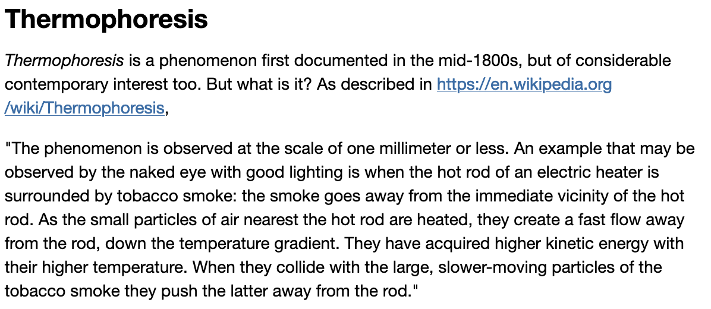
A bulk property you might not have known about: Thermophoresis
Etymology: thermo (“heat”) + phoresis (“to carry”)

Slide 2
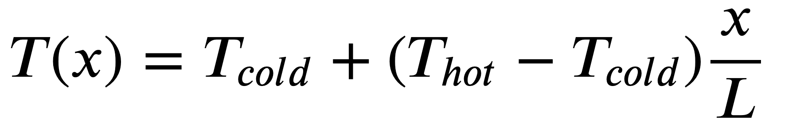


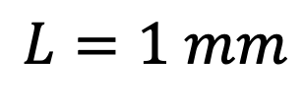
Setup for a thermophoresis experiment
$$x$$
$$0$$
$$L=1 mm$$
We set up a chamber with solvent (water), cold on one side and hot on the other.

Slide 3
Setup for a thermophoresis experiment
$$x$$
$$0$$
$$L=1 mm$$
Add some solute

Slide 4
One outcome of a thermophoresis experiment: thermophobic behavior
$$x$$
$$0$$
$$L=1 mm$$
Thermophobic behavior is the outcome predicted by Classical Statistical Mechanics, which is based on the assumption that the microscopic world is governed by Classical Mechanics.

Slide 5
But in real life, thermophilic behavior can happen too!
$$x$$
$$0$$
$$L=1 mm$$

Slide 6
Another possibility
$$x$$
$$0$$
$$L=1 mm$$

Slide 7
And yet another possibility
$$x$$
$$0$$
$$L=1 mm$$

Slide 8
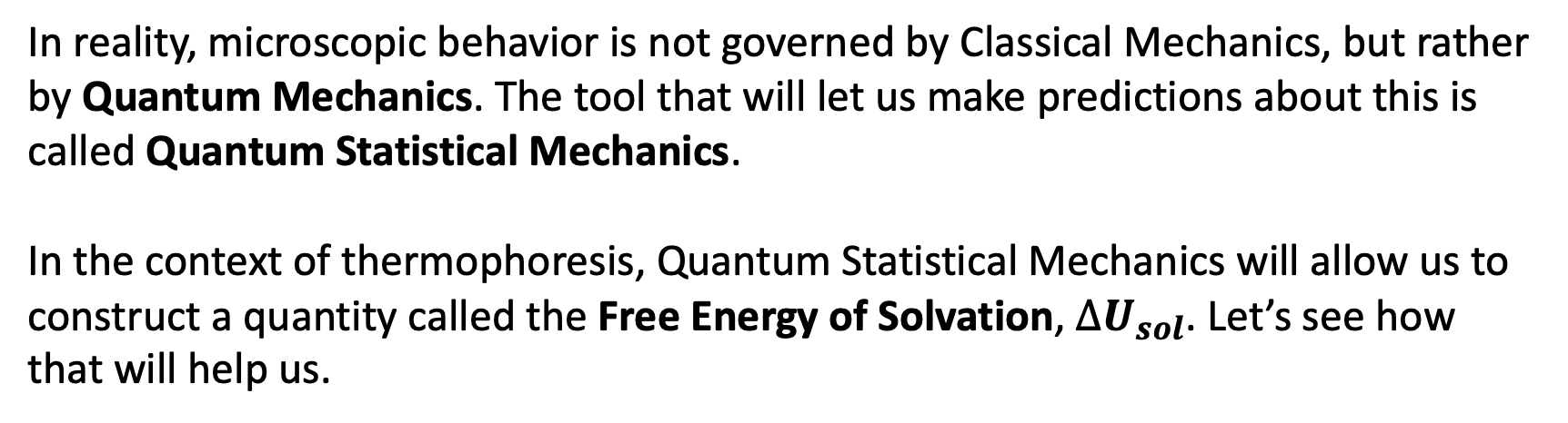
Why the difference?
?
?
$$x$$
$$0$$
$$L=1 mm$$
In reality, microscopic behavior is not governed by Classical Mechanics, but rather by Quantum Mechanics. The tool that will let us make predictions about this is called Quantum Statistical Mechanics.
In the context of thermophoresis, Quantum Statistical Mechanics will allow us to construct a quantity called the Free Energy of Solvation, ${∆U}_{sol}$. Let’s see how that will help us.

Slide 9
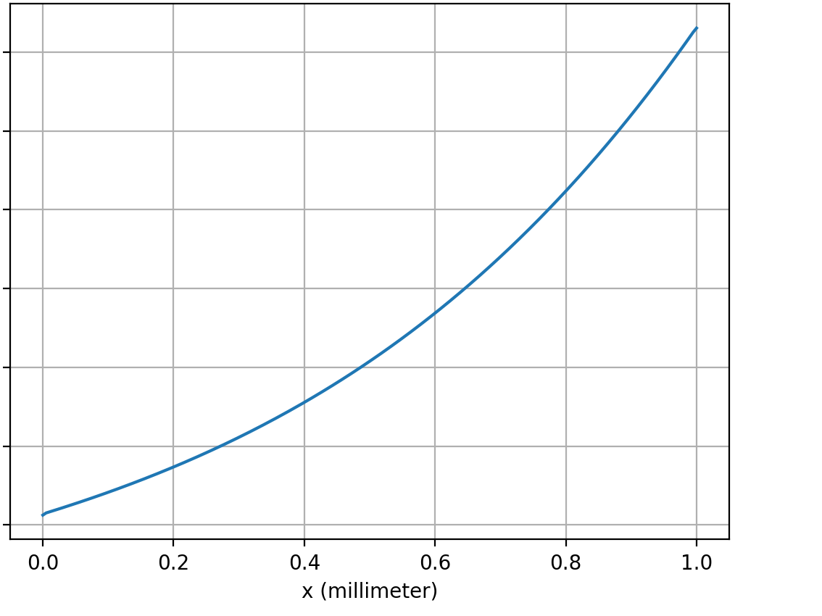
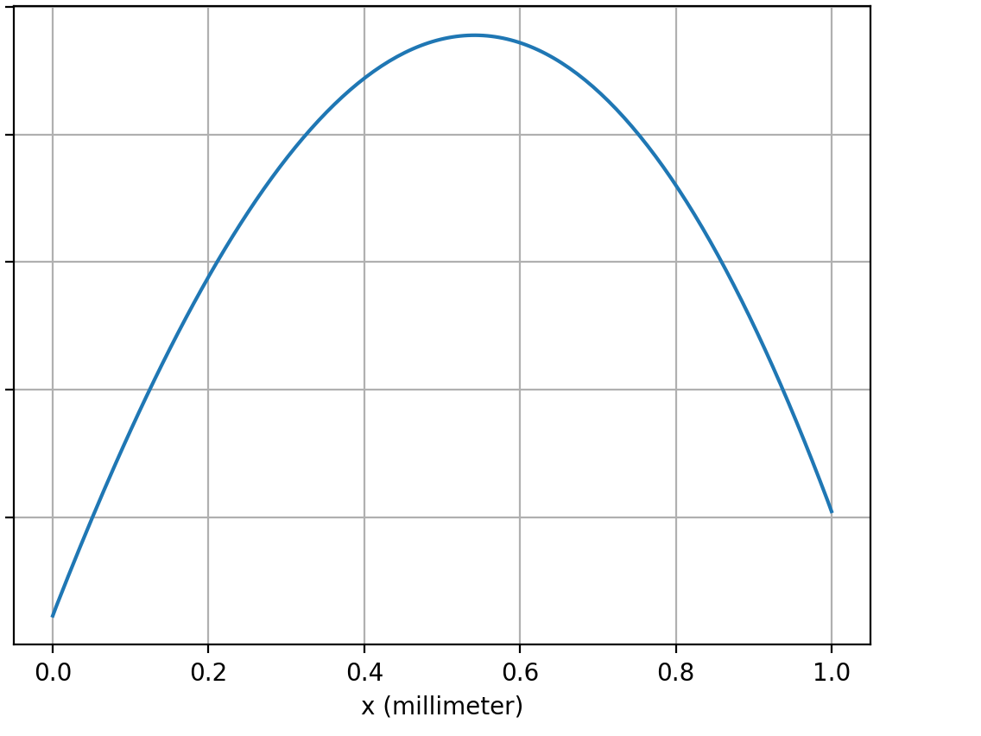
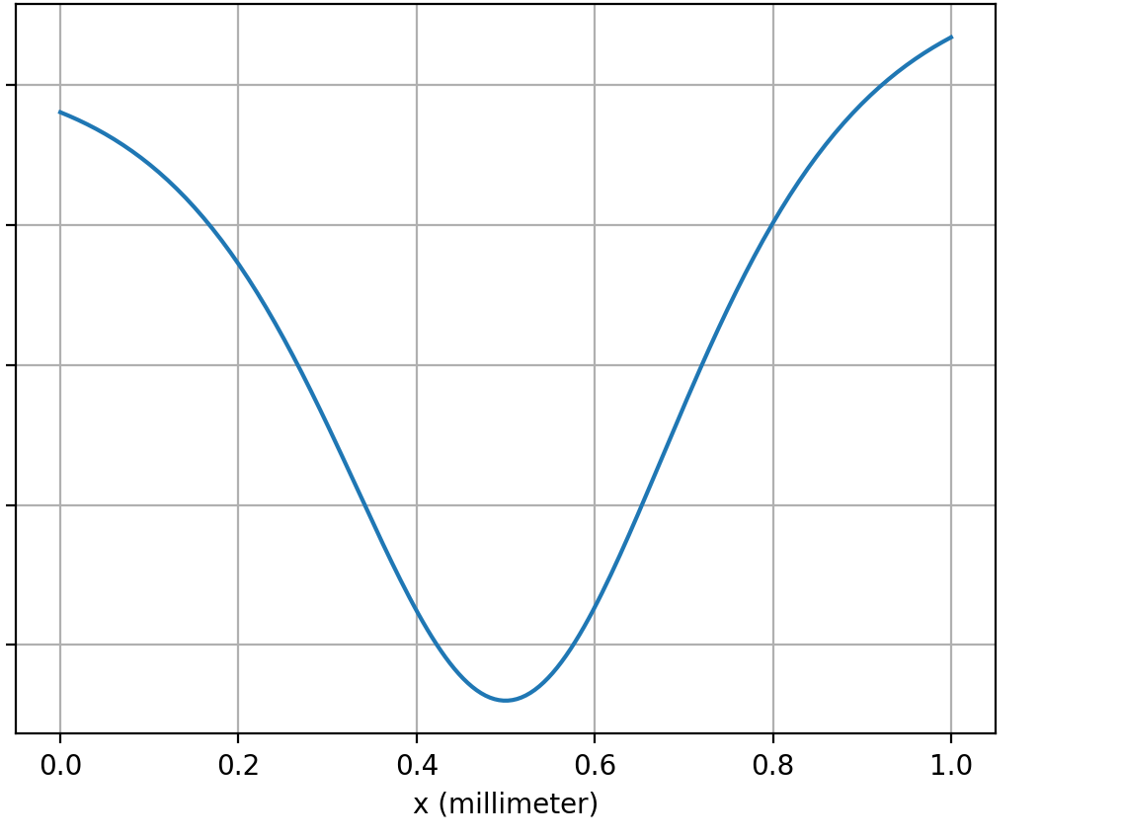



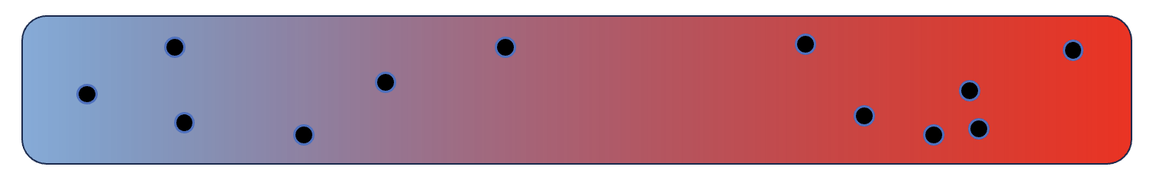



How ${∆U}_{sol}$ will help us predict whether thermophoresis will be thermophobic or thermophilic
$${∆U}_{sol}$$
$${∆U}_{sol}$$
$${∆U}_{sol}$$
A
C
B
D

Slide 10
How ${∆U}_{sol}$ will help us predict whether thermophoresis will be thermophobic or thermophilic
$${∆U}_{sol}$$
$${∆U}_{sol}$$
$${∆U}_{sol}$$
B
A
C
B
D

Slide 11
How ${∆U}_{sol}$ will help us predict whether thermophoresis will be thermophobic or thermophilic
$${∆U}_{sol}$$
$${∆U}_{sol}$$
$${∆U}_{sol}$$
B
D
A
C
B
D

Slide 12
How ${∆U}_{sol}$ will help us predict whether thermophoresis will be thermophobic or thermophilic
$${∆U}_{sol}$$
$${∆U}_{sol}$$
$${∆U}_{sol}$$
B
D
A
A
C
B
D

Slide 13
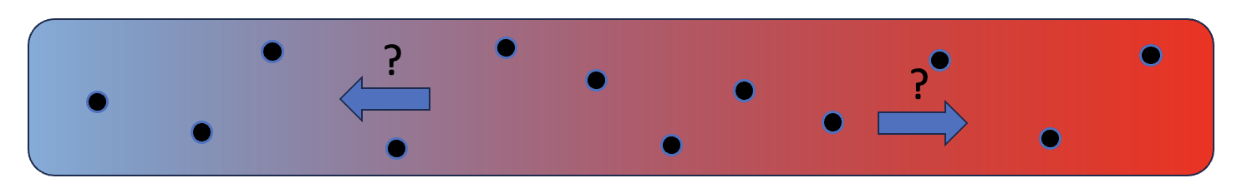
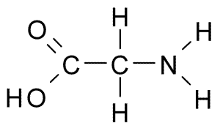
We can predict ${∆U}_{sol}$ by means of vibrational motion of solutes (which is not at all obvious)
It turns out that the temperature dependence of the frequency of these vibrations will let us predict thermophoretic behavior!
So that’s what we’ll tackle next.

